Slide 1

WEATHER FORECAST API
BY-
Arya Sharma
Jagrati Agrawal
Vedant Nigam
Institute Name-GLA UNIVERSITY
DEPARTMENT NAME - CEA

Slide 8
LITERATURE AND REVIEW
Weather forecasting has been one of the most challenging difficulties around the world because of both its practical value in popular scope for scientific study and meteorology. Weather is a continuous , dynamic ,multi-dimensional chaotic process, and data-intensive and these properties make weather forecasting a stimulating challenge. It is one of the most imperious and demanding
operational responsibilities that must be carried out by many meteorological services all over the globe. Various organizations / workers in India and abroad have done demonstrating using supported time series data manipulation. The various methodologies viz. statistic decomposition models, Exponential smoothing models, ARIMA models and their dissimilarities like seasonal
ARIMA models, vector ARIMA models using flexible time series, ARMAX models i.e. ARIMA with following informative variables etc., which has been used for forecasting purposes. Many trainings have taken place within the analysis of pattern and circulation of rainfall in many regions of the world.

Slide 9
METHODOLOGY
Weather APIs, in general, serve to provide developers and businesses with access to real-time and forecasted weather data. Here are some common gaps that weather APIs address Access to Real-Time Weather Data: Weather APIs offer current weather conditions, including temperature, humidity, wind speed, and more. This information is crucial for applications ranging from travel and event planning to agriculture and emergency management. Weather Forecasts: APIs often provide forecast data, helping developers integrate predictive weather information into their applications. This is valuable for businesses in industries like logistics, agriculture, and energy that depend on accurate weather predictions for planning. Geographic Specificity: Weather conditions can vary significantly across different locations. Weather APIs typically offer data at various levels of granularity, from global forecasts to hyper-local conditions.

Slide 10
TECHNOLOGY USED
AXIOS
REACT
NODE JS
OPEN WEATHER MAP

Slide 11
SYSTEM ARCHITECTURE
The architecture of a weather forecast API can vary depending on the specific provider and their implementation. However, I can provide a general overview of the typical components and architecture involved in a weather forecast API system:
Data Sources:
  Satellite Data: Weather satellites capture various data such as cloud cover, temperature, and precipitation.
  Radar and Sonar: Ground-based radar and sonar systems provide real-time information on precipitation and atmospheric conditions.
  Weather Stations: These are distributed sensors on the ground that measure temperature, humidity, wind speed, and other local conditions.
Data Ingestion:
  Raw data from various sources needs to be collected and ingested into the system.

Slide 12
Forecast Generation:
  Based on the user's request, the system generates weather forecasts for a specific location and time.
  This may involve querying the processed data, running prediction models, and combining various data sources.
Data Storage:
  Processed and historical weather data may be stored in databases for quick retrieval.
  Storage solutions can include traditional relational databases or specialized time-series databases.

Slide 13
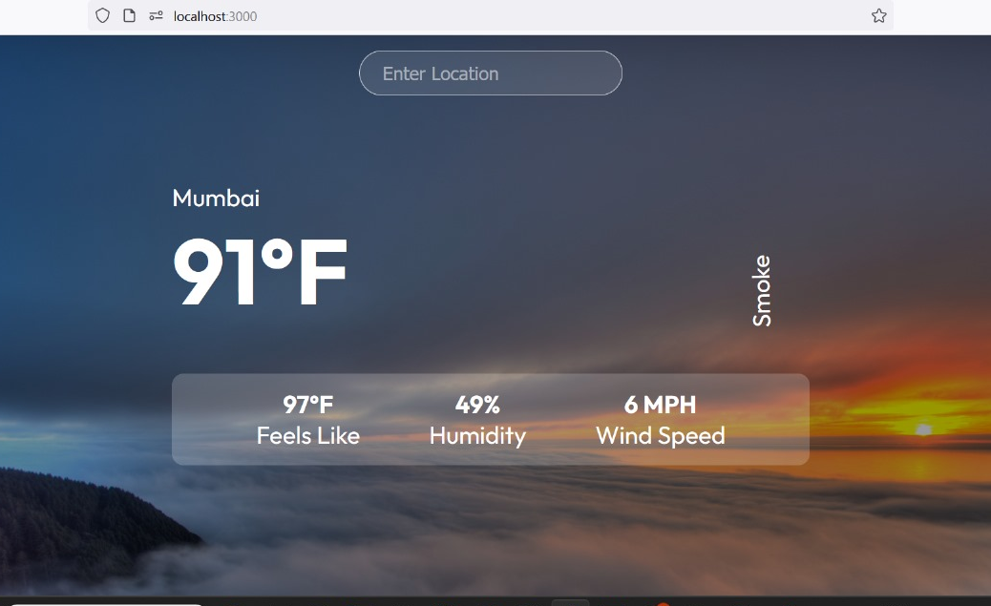
RESULT

Slide 14
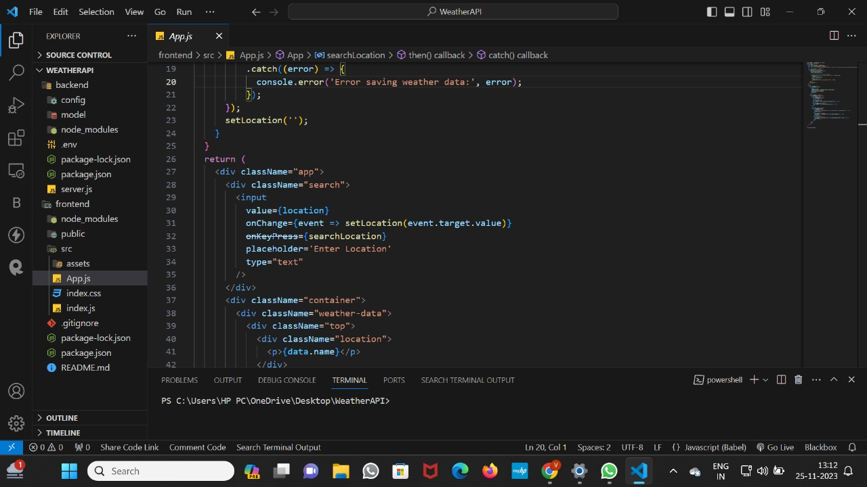
IMPLEMENTATION
HERE ARE SOME CODE SNIPPETS OF IMPLEMENTATION

Slide 15
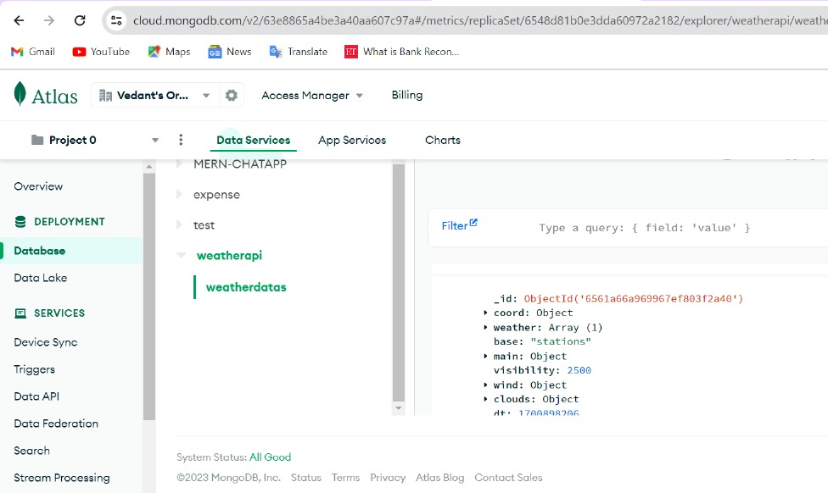
MONGODB ATLAS PAGE

Slide 16
Conclusion
This project demonstrates the creation of a Weather Forecast Application that provides users with accurate weather information using the Open Weather API.
the Open Weather API stands as a versatile and valuable tool, offering developers global access to real-time and forecasted weather data. Its robust features, including customization options and community support, make it pivotal in diverse applications, from mobile apps to IoT devices. The API's significance lies in its ability to empower decision-making processes, enhance user experiences, and contribute to educational initiatives in the realm of weather-related applications.

Slide 17
ANY QUESTIONS ? ASK AWAY

